Slide 1

The Game Of Minion

Slide 2
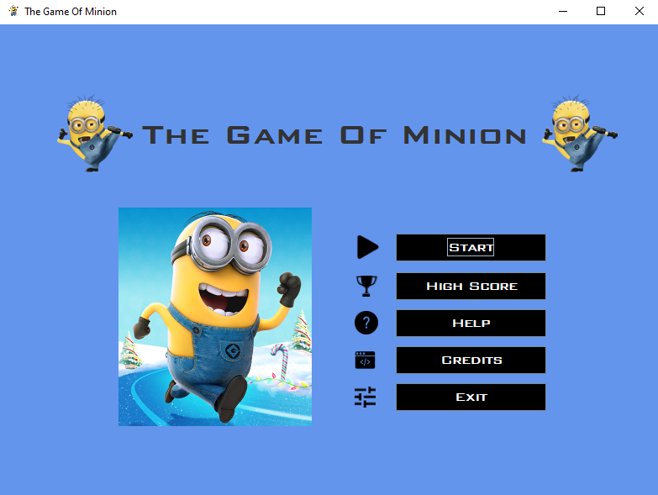
Start The Game
To Check High Score
Help
Exit The Game
Credits
Notes:
To Start The Game

Slide 3
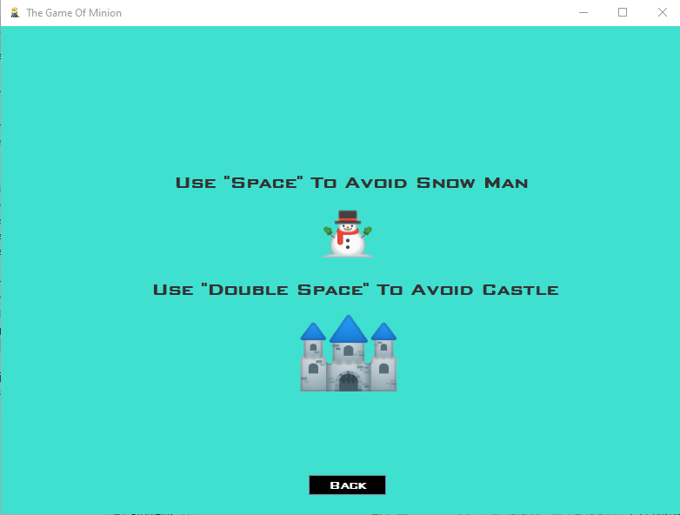
To Know The Instruction
Back

Slide 4
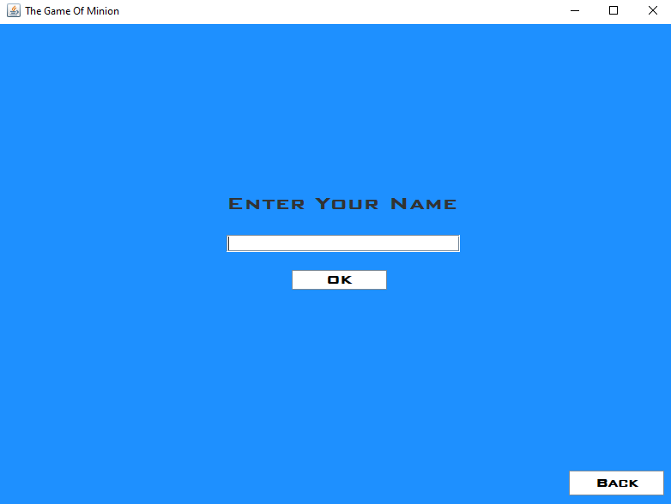
Entry Name
Back

Slide 5
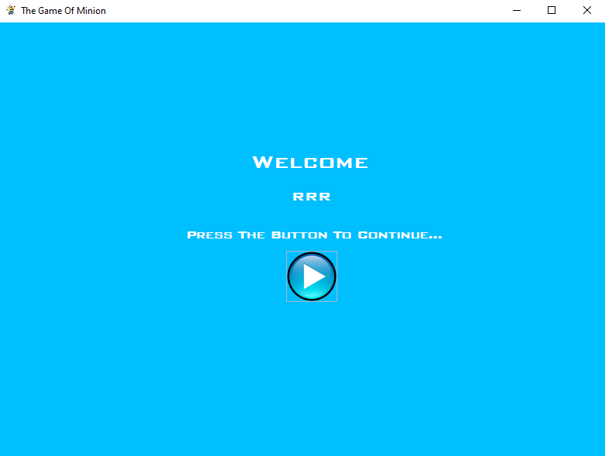
Press To Start

Slide 6
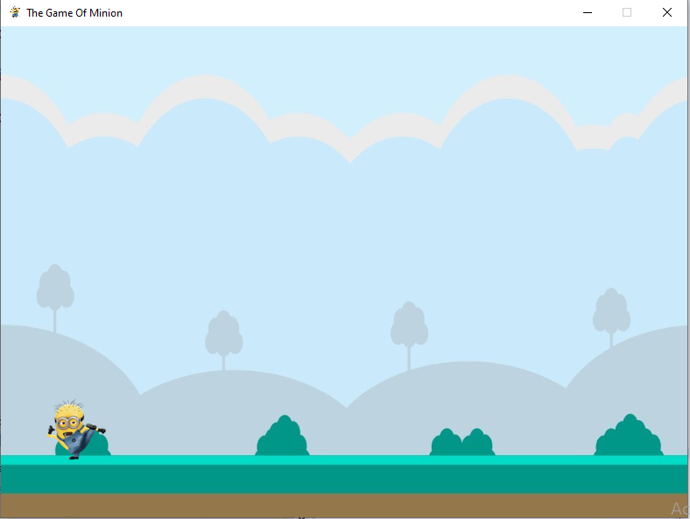
Game Window

Slide 7
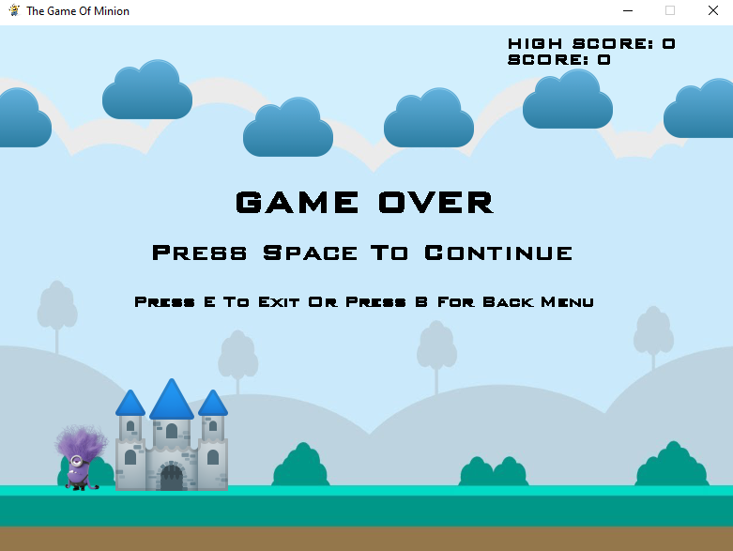
Game Over Panel
High Score
Press E to Save And Exit
Press B To Back Menu

Slide 8
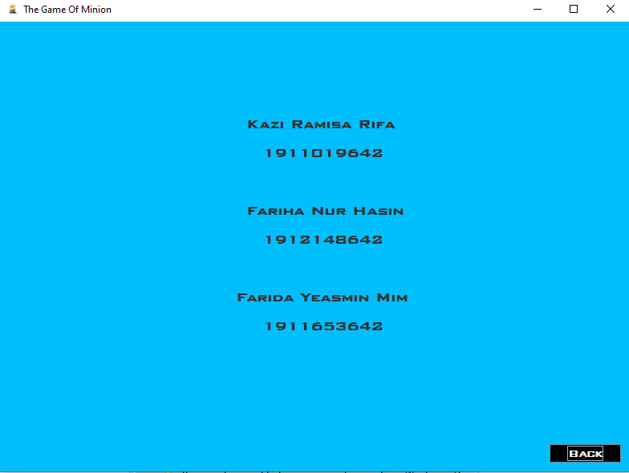
Credits

